Slide 1
MACHINE LEARNING BASED INTRUSION DETECTION SYSTEM

Slide 2
Table of Contents
Problem Definition
Introduction
Background Research
Algorithmic Overview
Methodology
Demonstration
Results & Evaluation
Conclusion
Future Scope

Slide 3
Problem Definition
1
What is intrusion detection ?

Slide 4
Intrusion detection can be defined as the ability to monitor and react to computer misuse.

Slide 5
Introduction
2

Slide 6
Intrusion Detection System
Detection Methodologies
Types of IDS Technologies
Network Based
Control attacks on network level
High fp and fn
Host Based
Control attacks on system level

Slide 7
Dataset
NSL-KDD Dataset- Why?
Features of NSL-KDD
Problems in NSL-KDD

Slide 8
Background Research
3

Slide 9
Research Papers
L. Dhanabal et. Al worked on Binary Classification.
C. Yin et. Al worked on Binary as well as Multi-class classification and reached 81.29% with the help of RNN.

Slide 10
Research papers (continued)
R. Vinayakumar et. Al produced the 76.5% F1 Score on Multiclass classification. Worked on both.
Y. Li et. Al worked only on multiclass classification. Currently a State of Art uses BAT-MC Model and achieved 84.25% Accuracy Rate.

Slide 11
Data Preprocessing & Algorithmic Overview
4

Slide 12
Data Preprocessing
Standard Scaling
Label Encoding
One Hot Encoding
Visualization
Exploratory data Analysis
Principal Component Analysis
t-SNE

Slide 13
Machine Learning Algorithms
K Nearest Neighbour
Naïve-Bayes
Logistic Regression

Slide 14
Algorithms (Continued)
Decision Tress
Random Forest
XG Boost
CAT Boost

Slide 15
Deep Learning
Artificial Neural Networks
Architecture
Drop out
Batch Normalization

Slide 16
Methodology
5
Tuning and Problems

Slide 17
Hyper Parameter Selection
Tuning of Algorithms with the help of Grid Search
Overfitting (Performing well on Train)
Imbalanced Data Set
Curse of Dimensionality (One Hot Encoding).

Slide 18
Demonstration
6
Explanation of code briefly from video

Slide 19
Evaluation
7

Slide 20
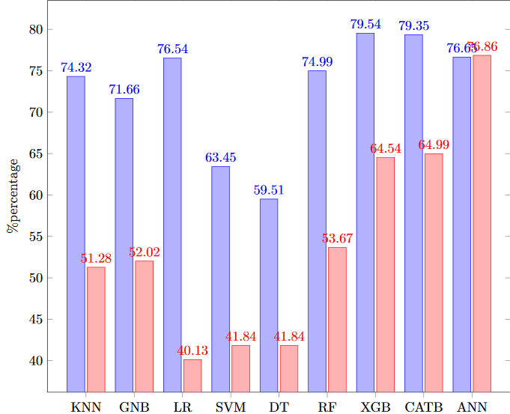
Accuracy and F1 Scores

Slide 21
Evaluation (Continued)
Low F1 and Accuracy- Why?
F1 vs Accuracy
Confusion Matrix
Achieved best results on Artificial Neural Networks with 76.86% F1 Score.

Slide 22
Discussion and Conclusion
8

Slide 23
Discussion
Dataset Problem
Imbalanced
Nominal Categorical features
Curse of Dimensionality
Multiclass Classification
Our work vs other scholars

Slide 24
Work Comparison
Our Work (ANN) | ANN (Other Scholar) | RNN | BAT-MC
76.86% | 76.5% | 81.29% | 84.25%

Slide 25
Conclusion
ANN works best
Works on Non-Lineraity and also for multi class.
Identified False positives and false negatives with Confusion Matrix.

Slide 26
Future Work
9

Slide 27
State of the Art
Bi-directional Long Short term Memory with Attention Model (BAT-MC).
Recurrent Neural Networks.

Slide 28
THANKS!
ANY QUESTIONS?

Slide 29
CREDITS
Special thanks to my Supervisor Dr. John Creagh who really guided me and helped me choosing the correct path for this thesis.
Special thanks for Mr. Vincent Ryan who really helped me a lot for finding my way in renowned Cork Institution of Technology from where the best journey of my life began.

